Slide 1
CSP/MATH 571 Lecture 2
Adam McElhinney

Slide 2
Reading in Data
Structured data
Comma separated values (.csv)
Tab separated values (.tsv)
R provides many convenient functions to read in data from a huge variety of sources
read.table() most common function
Strongly agree with Zumel’s recommendation “Avoid ‘by hand’ steps”
Why?

Slide 3
Reading in Data
See CSP571_Lecture2.R

Slide 4
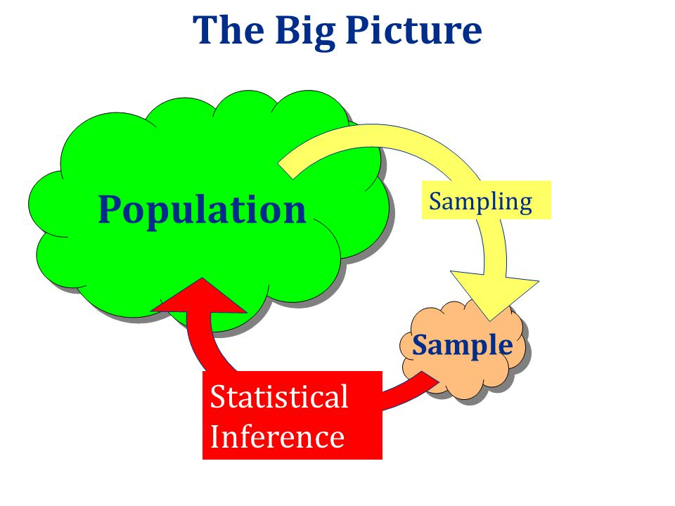
Describing Data
Population is the ENTIRE group that you are interested in studying
Sample is a subset of a population that you select and observe
Descriptive statistics are numbers that are used to summarize and describe SAMPLE data
Inferential statistics are statistics and conclusions made about a population based on data from a sample
Notes:
Image taken from: https://www.google.com/url?sa=i&rct=j&q=&esrc=s&source=images&cd=&cad=rja&uact=8&ved=0ahUKEwj559C716TRAhUr64MKHetdDJsQjRwIBw&url=http%3A%2F%2Fslideplayer.com%2Fslide%2F3999595%2F&psig=AFQjCNGKT8J8ItrbrPxYj_IVQyy0p88Rjg&ust=1483488477791808

Slide 5
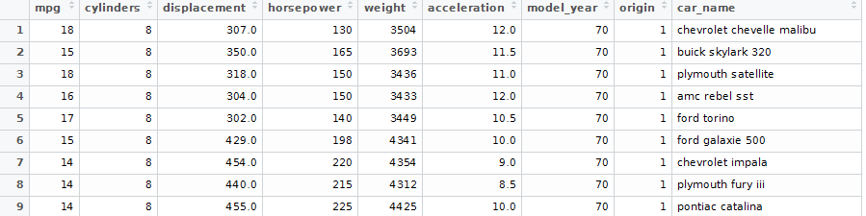
Describing Data
Observation: Single unit of data collected at a given time. This is typically each row in a data table (ie one instance of the plymouth satellite).
Variable: A set of variables describing some aspect across all observations (ie weight).

Slide 6
Types of Variables
Variables can be classified a number of different ways (not necessarily mutually exclusive)
Discrete versus continuous
Discrete variable: A variable that takes a fixed number of values (car model)
Continuous variable: A variable that takes an infinite number of values (height)

Slide 7
Types of Variables
Variables classified according to scale
Nominal/Categorical scale: Fixed number of values, cannot be ordered (ie hair color)
Caution: Avoid imposing order to nominal variables without verifying your assumptions
Ordinal scale: Fixed number of values, can be ordered (ie: low income, medium income, high income). Impossible to determine the magnitude of the difference (ie cannot subtract medium income from low income)
Interval scale: A variable such that interval values between the variables can be compared. An interval variable is similar to an ordinal variable, except that the intervals between the values of the interval variable are equally spaced. However, the variable CANNOT be compared on a ratio scale (ie: temperature on Fahrenheit scale). A value of zero does NOT mean there is none of this.
Ratio scale: A variable where the intervals and the ratios can be compared (ie: temperature Kelvin). A value of 0 means there is none of this.

Slide 8
Types of Variables
Other classifications of variables and key terms
Dichotomous: A variable that can contain only two values (ie: On or Off)
Binary: A dichotomous variable that is encoded as 0 or 1 (ie: On = 0, Off = 1)
Primary key: A variable that is a unique identifier for a particular record. (ie: SSN may be the primary key for describing a citizen, customerId may be the primary key for describing a customer in a database)

Slide 9
Types of Variables
See CSP571_Lecture2.R

Slide 10
Describing Data
Central tendency
Mode: Most frequently occurring value in a series. Ties either reported as the mean , or both values are returned.
Median: Middle value of a sorted series of data. Even number of values have the mean of the middle two values reported.
Preferred when the data is skewed or subject to outliers
WARNING: A median value significantly larger than the mean value should be investigated!!!
Mean (average): Sum of all values divided by the number of values.
Thought experiment: Bill Gates in an elevator

Slide 11
Describing Data
Range: Maximum value - minimum value. Simple measure of variation in a data set.
Quantiles: each of any set of values of a variate that divide a frequency distribution into equal groups, each containing the same fraction of the total population.
Quartiles: Measures that divide the data into four even groups at the 25% mark, 50% mark, and 75% mark
Deciles: Measures that divide the data into ten equal groups (10%, 20%, 30% etc)

Slide 12
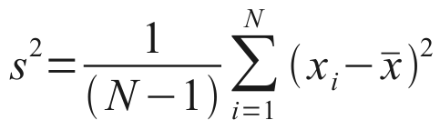
Describing Data
Variance: A measure of how much the values of a variable differ from the mean (ie how “spread-out” the variable is). Sample variance (variable calculated based on a subset (sample) of an observed populate) denoted below.
Standard deviation: Square root of the variance (denoted as s)

Slide 13
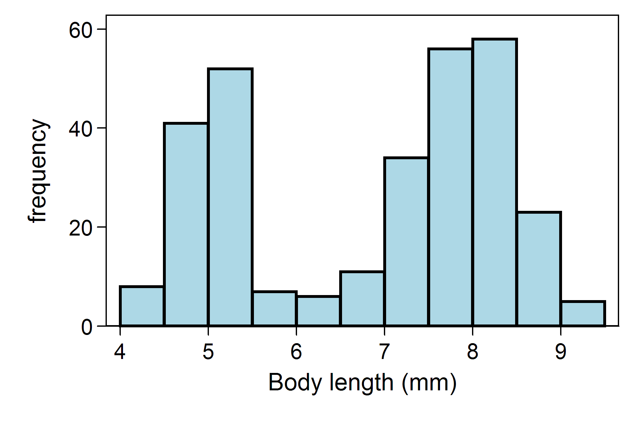
Describing Data
Multimodal: a probability distribution with two or more modes
Bimodal: a probability distribution with two modes
“Questioning the underlying reason for distributional non-unimodality frequently leads to greater insight and improved deterministic modeling of the phenomenon under study.”
Very common in real-world data
Best practice is to look into this!
Notes:
http://www.itl.nist.gov/div898/handbook/eda/section3/histogr4.htm

Slide 14
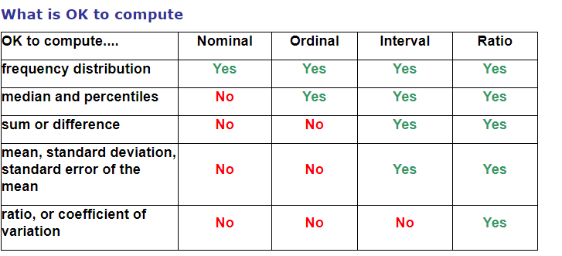
Types of Variables and Applicable Statistics
Notes:
Taken from: https://www.graphpad.com/guides/prism/7/statistics/the_different_kinds_of_variabl.htm?toc=0&printWindow

Slide 15
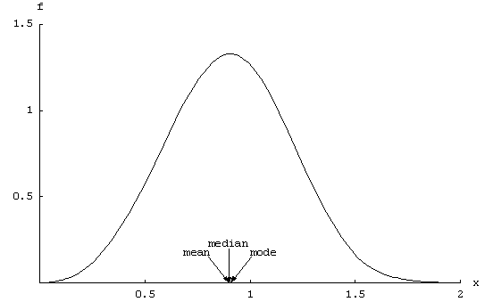
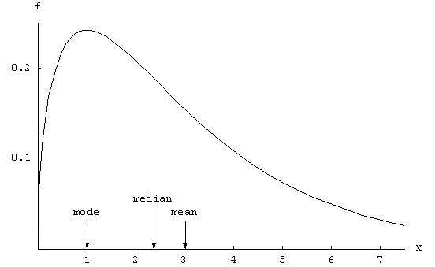
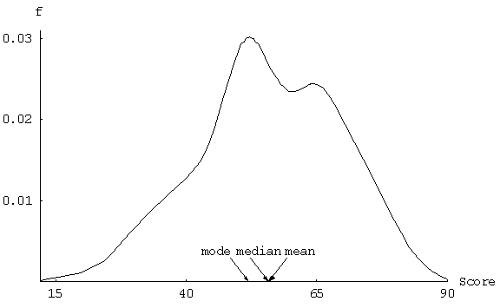
Describing Data
What explains the difference in the mean, median and modes of these variables?
What are the implications for analysis from these differences in values?
Notes:
Images taken from: https://ww2.amstat.org/publications/jse/v13n2/vonhippel.html

Slide 16
Bar Charts and Frequency Histograms
Bar chart: used to display the relative frequencies for different variables
Frequency histogram: A histogram is a display of statistical information that uses rectangles to show the frequency of data items in successive numerical intervals of equal size.
Obtained by splitting the range of the data into equal-sized bins (called classes). Then for each bin, the number of points from the data set that fall into each bin are counted.
Both charts useful for detecting outliers
Outliers: extremely high or low values that do not fall near any other data points
Unusual cases
Data entry errors
Notes:
http://searchsoftwarequality.techtarget.com/definition/histogram
http://www.itl.nist.gov/div898/handbook/eda/section3/histogra.htm

Slide 17
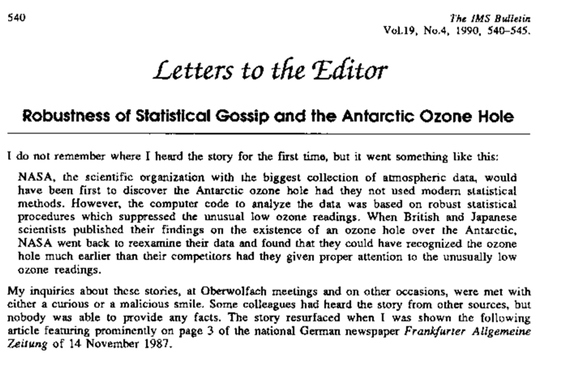
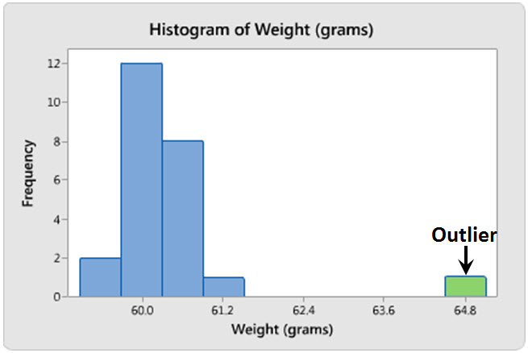
Outliers
Notes:
Anecdote about how some scientists studying the ozone initially missed the whole in the arctic because they threw out the data because they called it an “outlier”

Slide 18
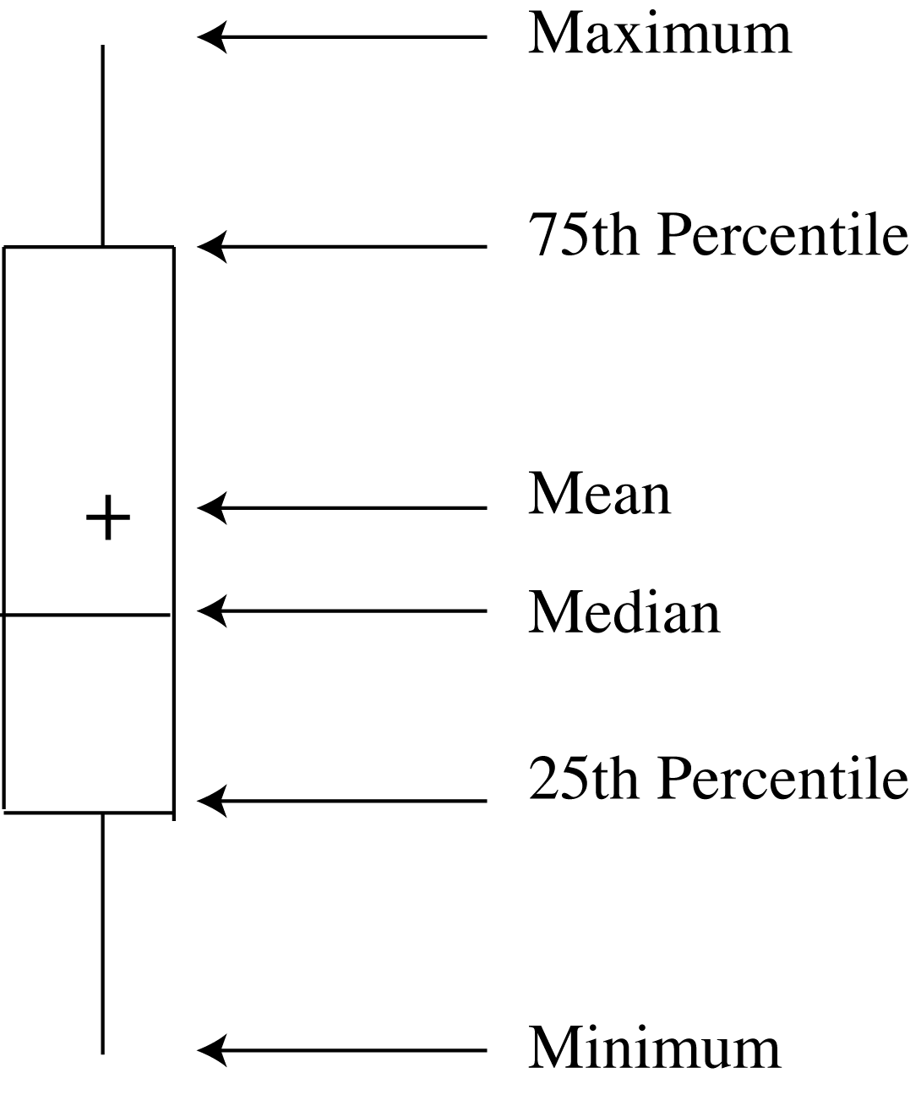
Boxplots
Multiple ways of doing boxplots
Method 1 (not preferred)
Lowest value
Lower quartile (Q1)
Median (Q2)
Upper quartile (Q3)
Highest value
Mean

Slide 19
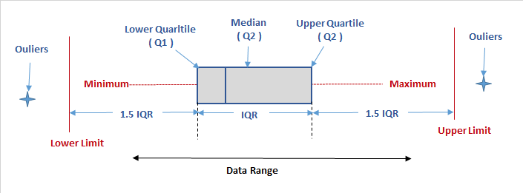
Boxplots
Method 2 (preferred)
Low outliers
Lower limit = Q1 - 1.5 IQR
Median (Q2)
Upper quartile (Q3)
Upper limit = Q2 + 1.5 IQR
IQR = Q3 - Q1

Slide 20
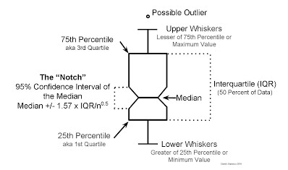
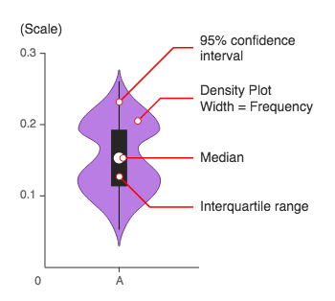
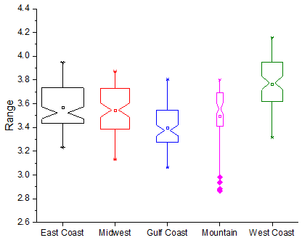
Boxplots
Other methods exist; make sure to ask and label your box-plots!
Notes:
Notched box plot: Displays the confidence interval of the median
Variable width box plot: Width of the box corresponds to the frequency of that variable
Violin plot: Shows the density of that variable at that point

Slide 21
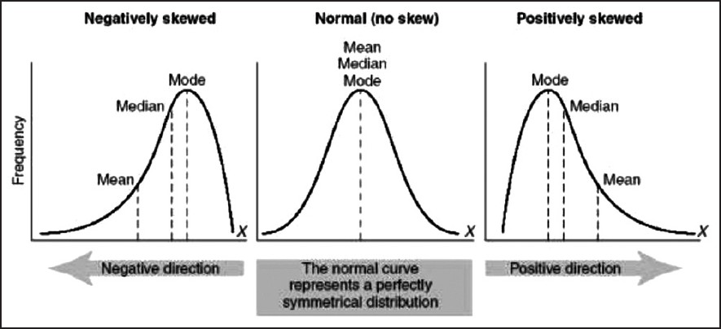

Shape
Skewness: a measure of the degree of asymmetry (lack of symmetry) of a variable
Value of 0 indicates a perfectly symmetric variable
Positive skewness → the majority of observations are to the left of the mean
Negative skewness → the majority of observations are to the right of the mean

Slide 22
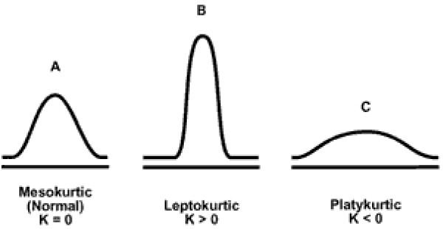
Shape
Kurtosis: A measure of how “tailed” a variable is
Variables with a pronounced peak near the mean have high kurtosis
Variables with a flat peak have a low kurtosis score
Values for skewness and kurtosis near zero indicate the variable approximates a normal distribution

Slide 23
Where to Get Data?
•Where to find data
–Government agencies
•US Census Bureau
•Chicago Data Portal
•Nat. Oceanic and Atmospheric Admin.
–Research organizations
•Google Public Data Explorer
•Kaggle datasets
•New York Times
•UCI Machine Learning Repository
•Lending Club
•NASA Data Catalog

Slide 24
Confidence Intervals
So far we have discussed sample statistics
Each sample statistic has a corresponding unknown population value called a parameter
How well do these sample statistics estimate the underlying population value?
Confidence intervals are a range of values which is likely to contain the population parameter of interest

Slide 25
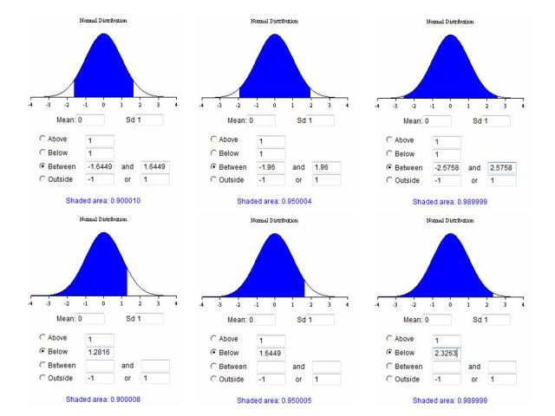
Confidence Intervals
Confidence intervals can be 1-sided or 2-sided
Confidence intervals (2-sided; assume 95% confidence level) can be interpreted as if the SAME population is sampled on numerous occasions, the resulting intervals would contain the true population parameter 95% of the time
Notes:
Image taken from: https://www.google.com/url?sa=i&rct=j&q=&esrc=s&source=images&cd=&cad=rja&uact=8&ved=0ahUKEwiO76avmKvRAhUM1oMKHetNBHEQjRwIBw&url=http%3A%2F%2Fwww.analystforum.com%2Fforums%2Fcfa-forums%2Fcfa-level-i-forum%2F91316368&psig=AFQjCNGcqtCDNfqfLIpQBPg94_wNNgFJhg&ust=1483712073925321

Slide 26
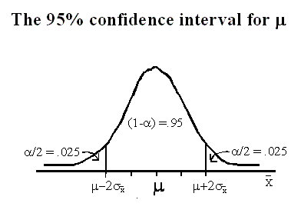
Confidence Intervals
Confidence intervals are calculated at a given confidence level (chosen by the analyst, such as 95%, 99%, etc
How to pick the confidence level?
Higher the confidence level, wider the interval will be
Census Bureau: 90% confidence interval
Basel (banking) risk regulations: 99% confidence interval
Notes:
Census Bureau cite: https://www.census.gov/did/www/saipe/methods/statecounty/ci.html
Basel: http://www.bis.org/publ/bcbs148.pdf

Slide 27


How to compute a confidence interval?
For a normal distribution, a 2-sided confidence interval for the mean can be computed by:
Compute the standard error of the sampling distribution
s is the standard deviation of a population
n is the number of observations in the sample
Pick your value of alpha
Determine the value of
Compute the confidence interval

Slide 28
Computing Confidence Intervals in R
CSP571_Lecture2.R

Slide 29
Hypothesis Tests
Hypothesis testing: a formal process to determine whether to reject a null hypothesis, based on sample data
Null hypothesis: what would be expected if there was nothing unusual about the measured values collected. Can be thought of as the absence of effect or the generally accepted wisdom.
Alternative hypothesis: opposite of the null hypothesis.
Null and alternative hypothesis must be mutually exclusive (ie, if one is true then the other is false)
Can have one-tailed or two-tailed hypothesis

Slide 30
Hypothesis Tests
Type 1 Error: When one rejects the null hypothesis when in reality, one should have not rejected the null hypothesis
Type 2 Error: When one fails to reject the null hypothesis when in reality it should be rejected.
Note that “failing to reject the null hypothesis” is NOT the same as “accepting the null hypothesis”. It simply means that the data are not sufficiently persuasive for us to prefer the alternative hypothesis over the null hypothesis.

Slide 31
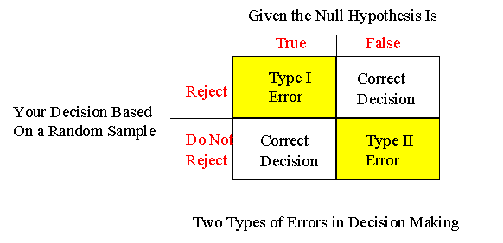
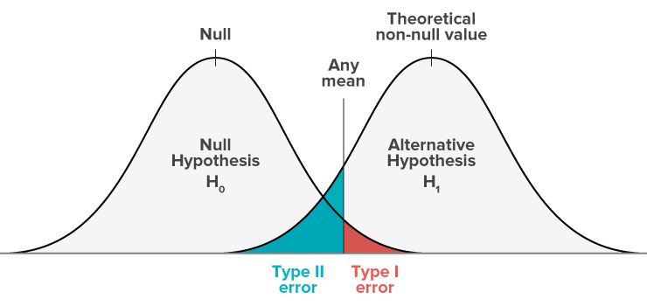
Hypothesis Testing

Slide 32
Hypothesis Tests
Suppose building specifications in a certain city require that the average breaking strength of residential sewer pipe be more than 2,400 pounds per foot of length (i.e., per linear foot). Each manufacturer that wants to sell pipe in that city must demonstrate that its product meets the specification. We test 50 sections of pipe. Mean breaking point is 2460 with a population sd of 200.
H0: mu <= 2400
Ha: mu > 2400
Test statistic = (2460-2400)/(200/sqt(50)) = 2.12
Alpha =.05
Rejection region = 1.645
Therefore reject the null in favor of the alternative
Notes:
http://www.stat.ucdavis.edu/~ntyang/teaching/12SSII/lecture06.pdf

Slide 33
Reading in Web Data
Web scraping: process for extracting data from human readable websites
WARNING!! This activity ranges from perfectly legal and encouraged by website owners, to being discouraged by website owners to being outright illegal. USE CAUTION!

Slide 34
Reading in Web Data
R is typically not the best tool for this, but rvest package has made this feasible
Better tool: Selenium + Python (may cover later in course if we have time)

Slide 35
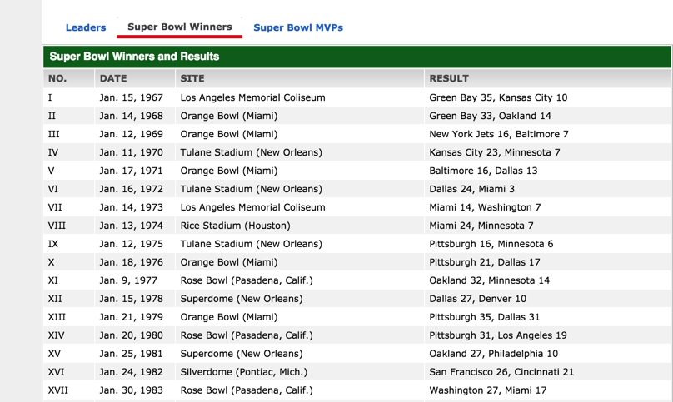
Reading in Web Data
Easiest form of web data is html table

Slide 36
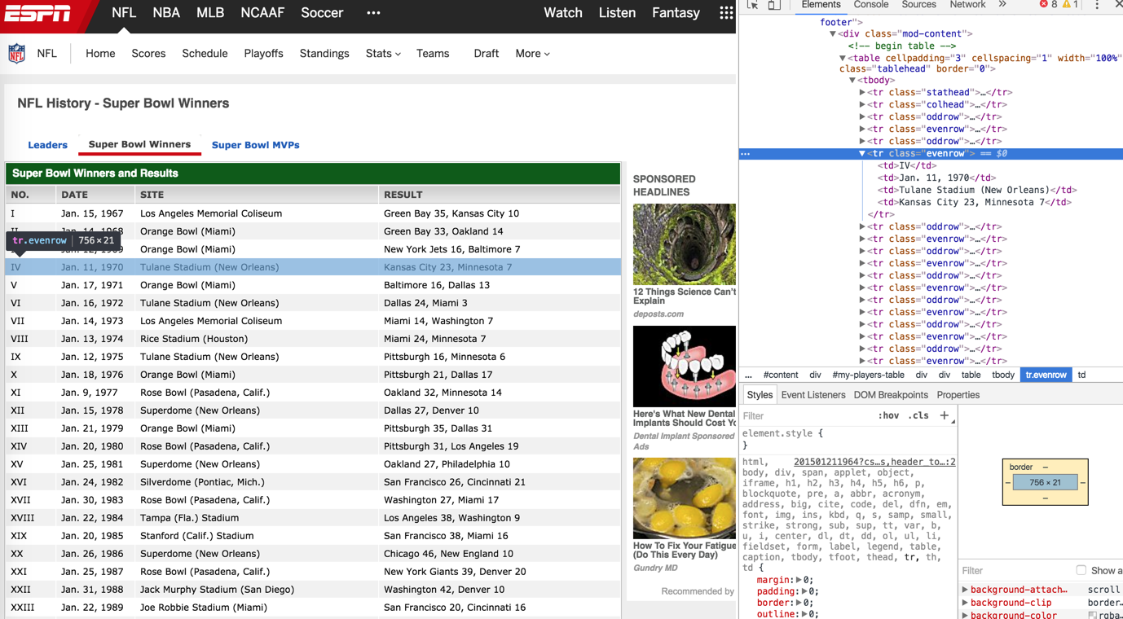
Reading in Web Data
Using most web browsers, you can right click and select “inspect” and view the contents of the html
This is very useful when reading in web data

Slide 37
Reading in Web Data
See CSP571_Lecture2.R

Slide 38
Reading in Web Data
Html tables are defined with a “<table ...>” tag and closed with “</table>” tag
Each row is defined with a “<tr>” tag and closed with “</tr>” tag
Each cell is defined with a “<td>” tag and closed with a “</td>” tag

Slide 39

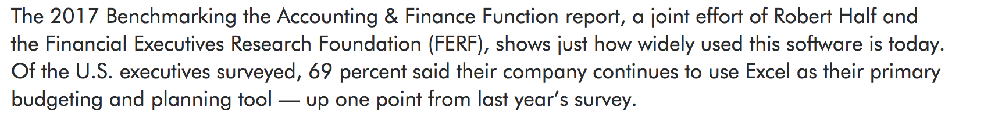
Reading in Excel Data
Excel is EVERYWHERE!
May or may not be a good thing
Reading and writing from and to Excel can be very convenient
Easy way to integrate into existing business processes
Notes:
https://www.roberthalf.com/blog/salaries-and-skills/excel-for-finance-professionals-still-king-of-the-spreadsheets
https://news.microsoft.com/1996/05/20/more-than-30-million-users-make-microsoft-excel-the-worlds-most-popular-spreadsheet-program/#E5ZPuqpTVck5WgDR.99

Slide 40
Reading in Excel Data...
Sample Super Store sales data
3 Sheets
Orders: Contains a list of transactions
Returns: Contains a list of transactions that were later returned to the store
People: Matches a sales-person to a region
Review data manipulation in R
See CSP571_Lecture2.R

Slide 41
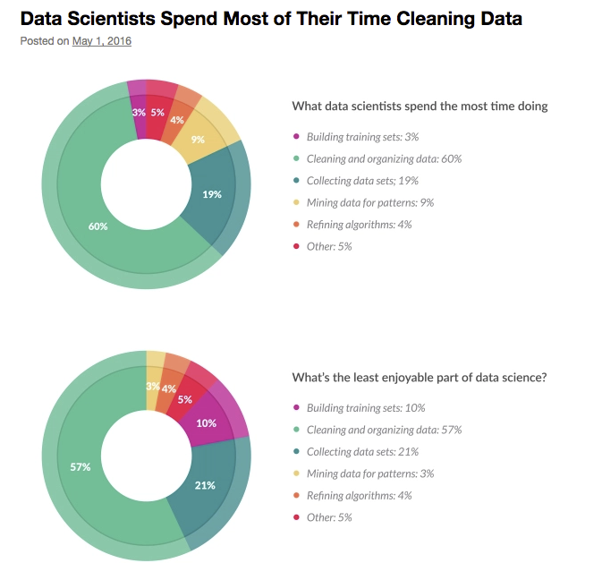
Data Munging
Data Munging: Process of cleaning and manipulating data sets to facilitate later analysis. Sometimes call “data wrangling”, “data cleaning”, etc.
Significant chunk of what a Data Scientist does
We will be practicing this a LOT!
Joke about cleaning data
Notes:
https://whatsthebigdata.com/2016/05/01/data-scientists-spend-most-of-their-time-cleaning-data/

Slide 42
Set Operations on Data
Joining data: Process of combining multiple data sets into one data set by adding additional columns
Sometimes called merging data
Concatenating data: Process of combining multiple data sets into one data set by adding additional rows
Sometimes also called “append” or “union”
Treatment of non-overlapping columns can differ by language
Certain implementation details vary by term and by language
Handling of duplicate rows
Handling of nulls

Slide 43
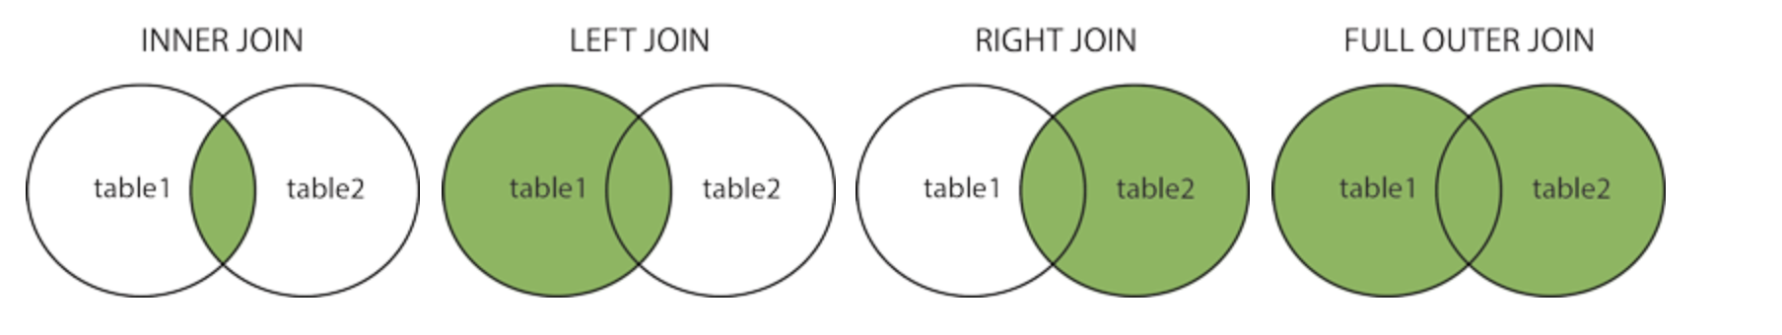
Join Operations
Image two tables, A(n by m), B(x by y)
Inner join: Return records that have matching values in both tables.
Left join: Return all records from left table and matched records from right table.
Right join: Return all records from right table and matched records from left table.
Full outer join: Return all records where match in either left or right table. Conceptually equivalent to left join and a right join.

Slide 44
Join Operations
Join Type | Min Resulting Rows | Max Resulting Rows
Inner | None | min(n, x)
Left | n | n * x
Right | x | x * n
Full outer | max(n, x) | x * n

Slide 45
Joining Operations
Left
Right
 | A | B | Key
0 | A0 | B0 | K0
1 | A1 | B1 | K1
2 | A2 | B2 | K2
3 | A3 | B3 | K3
 | C | D | Key
0 | C0 | D0 | K0
1 | C1 | D1 | K1
2 | C2 | D2 | K2
3 | C3 | D3 | K3

Slide 46
Joining in R
See CSP571_Lecture2.R

Slide 47
Concatenate Data
See CSP571_Lecture2.R

Slide 48
Dates and Times in R
Unix time (aka POSIX time aka Epoch time) is a very commonly used date and time format
Measured as number of seconds that have elapsed since midnight Jan 1, 1970
Minus leap seconds
R stores dates and times using this format
Notes:
Easier data conversion.
Feasible to count secs.

Slide 49

Dates and Times in R
CAUTION!!!!
Date and time math is extremely complicated
Not recommended to implement your own tools for this
Leverage existing tools and libraries!

Slide 50
Why is date math so hard?
Length of a year is not an integer
Leap years
Leap seconds
Skipped days
Samoa skipped a day!
Months durations are inconsistent
Time zones
Daylight savings time
Not everyone does it
Some do it after different times!
Started at different times
Precision needed
Seconds?
Milliseconds?
Changes in time zones
Political Challenges
Israel and Palestine disagree on time zones in SAME location
Julian versus Gregorian calendar!
Excellent Video (worth ten minutes of your time)

Slide 51
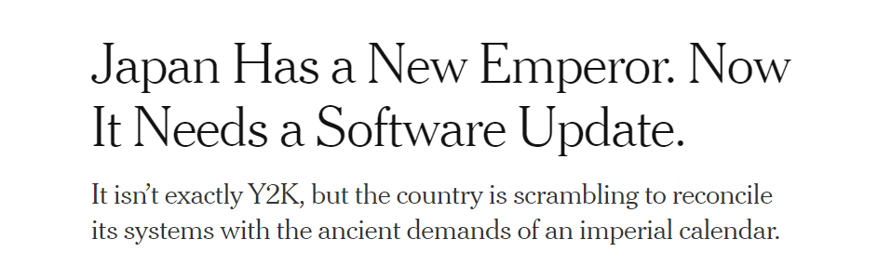
Why is date math so hard? ...
Japanese calendars revert back to year 1 with the ascension of a new emperor
Example of difficulties with datetimes
Notes:
https://www.nytimes.com/2019/04/23/business/japan-reiwa-calendar.html

Slide 52
R Dates and Times
See CSP571_Lecture2.R

